Slide 1
Textures & Multithreading
DirectX Day 3

Slide 2

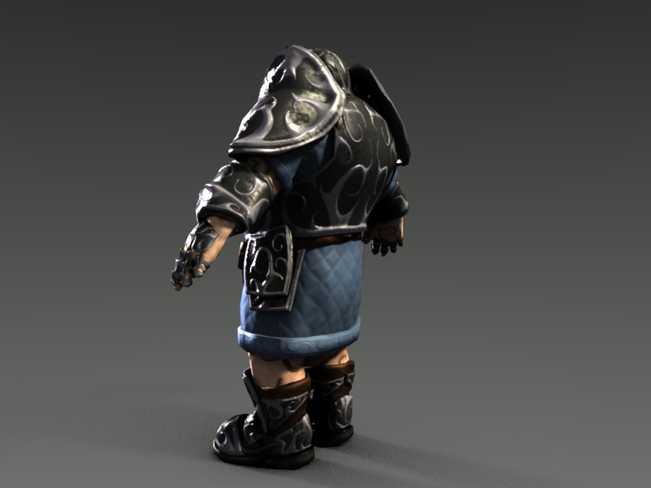
Modern Texturing: Beyond Color

Slide 3
Texturing: Applications.
Diffuse Maps:
Color data mapped across polygons. What people commonly think of when we refer to textures.
Specular Maps:
Lighting control map, controls the “shininess” of a surface.
Normal Maps:
Lighting control map, adds per-pixel normals to create the illusion of more detailed geometry.
Reflection / Environment Maps:
Used to help simulate highly reflective surfaces such as smooth metal, glass and certain plastics.
Also may be used to inexpensively represent distant scenery, typically called a “SkyBox”.

Slide 4
Texturing: Kinds of Textures
1D (ID3DTexture1D)
Gradient maps, Cell Shading, misc data storage.
1D Array (ID3DTexture1D)
An array of 1D textures that are all the same size and format.
2D (ID3DTexture2D)
Most common type, Diffuse maps, Specular maps, Normal maps, Detail maps, Blend Maps, etc…
2D Array (ID3DTexture2D)
An array of 2D textures that are all the same size and format.
3D (ID3DTexture3D)
Least common type, can be used for volumetric type effects and many other effects where 2D surface data is not enough.
CUBE* (ID3DTexture2D)
Comprised of 6 2D textures forming an inward facing cube. Common in most games, Reflection maps, Sky Boxes, Environment maps. Often sampled with a directional vector.
*Cube Maps are a specialized form of the 2D Array type.

Slide 5
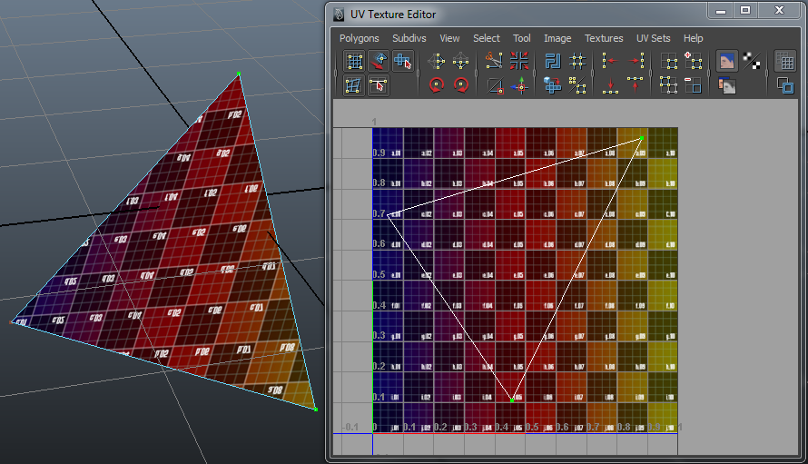
Texturing: UV Coordinates
Describes where a vertex falls within a texture.
By describing the three UV’s across a triangles surface we instruct our hardware how to display the image on the surface of the polygon.
UV data(Texture Space) is independent of the 3D Space.

Slide 6
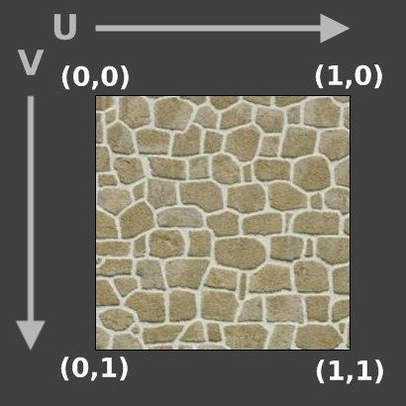
Texturing: D3D UV Space

Slide 7





Texturing: UV data beyond 0-1
(0,0)
(1,0)
(0,1)
(1,1)
WRAP
MIRROR
CLAMP
BORDER

Slide 8
The Pixel Shader Stage
This stage receives the output from the rasterizer stage.
Each rasterized pixel is operated on by the currently bound pixel shader.
The pixel shader determines the color that is actually sent to the Output Merger Stage.
From there the OM Stage determines if we discard, blend, or display a resulting pixel as is.
Because the pixel shader output is generally color data on the surface of a triangle, it is the most logical place to sample texture data. (At least as far as surface color is concerned)
Every programmable stage can access textures.

Slide 9
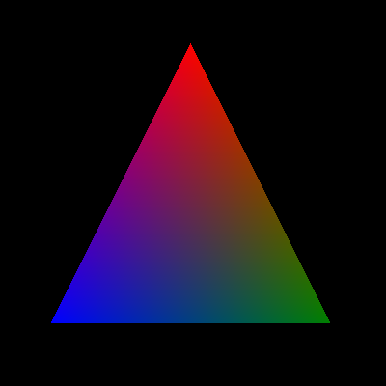
Pixel Shader: Interpolation
You may have noticed UV data is stored on a per-vertex basis. Three points on a texture do not seem like enough information to fill the interior of a triangle.
One key feature of the Pixel Shader Stage is the ability to receive “interpolated” data from the Rasterizer Stage.
Interpolation (in the case of triangles) is a weighted average of the data within the three vertices that make up the rasterized shape. This is how each pixel can receive data unique to itself.
0.4,0.9
1,0,0
0.4,0.7,0.15
0.32,0.301
0.1,0.3
0,0,1
0,1,0
0.9,0.1
COLORS
TEXCOORDS

Slide 10
Texturing: ID3D11SamplerState
Samplers are objects that allow us to exert a high degree of control over how texture data is retrieved.
They control the active addressing mode on each texture space axis: WRAP, CLAMP, REPEAT, etc..
They also control filtering behavior.
Texels(texture pixels) do not map 1:1 to pixels that are shown on screen.
In a 3D environment, if an object is far away or at an angle, you don’t need the maximum resolution of the texture.
The hardware can choose a lower resolution of the texture instead. This in known as Mip-Mapping.
As long as your texture has a Mip-Map pyramid this behavior is automatic.
Samplers allow you to choose one of many filter modes that determine how the various levels are combined.
The chosen behavior can have a major impact on visual quality.

Slide 11
ID3D11ShaderResourceView
A Shader Resource View(SRV) is required to bind certain resources like textures and particular types of buffers to the rendering pipeline.
An SRV allows a pipeline stage to READ data from a resource but not WRITE.
For example: to sample a texture in the pixel shader stage, you must first bind the corresponding SRV to the appropriate texture slot in the stage.

Slide 12
Sample Pixel Shader
texture2D baseTexture : register( t0 ); // first texture
texture2D detailTexture : register( t1 ); // second texture
SamplerState filters[2] : register( s0 ); // filter 0 using CLAMP, filter 1 using WRAP
// Pixel shader performing multi-texturing with a detail texture on a second UV channel
// A simple optimization would be to pack both UV sets into a single register
float4 main(float2 baseUV : TEXCOORD0, float2 detailUV : TEXCOORD1, float4 modulate : COLOR) : SV_TARGET
{
float4 baseColor = baseTexture.Sample( filters[0], baseUV ) * modulate; // get base color
float4 detailColor = detailTexture.Sample( filters[1], detailUV ); // get detail effect
float4 finalColor = float4(lerp(baseColor.rgb, detailColor.rgb, detailColor.a), baseColor.a);
return finalColor; // return a transition based on the detail alpha
}

Slide 13
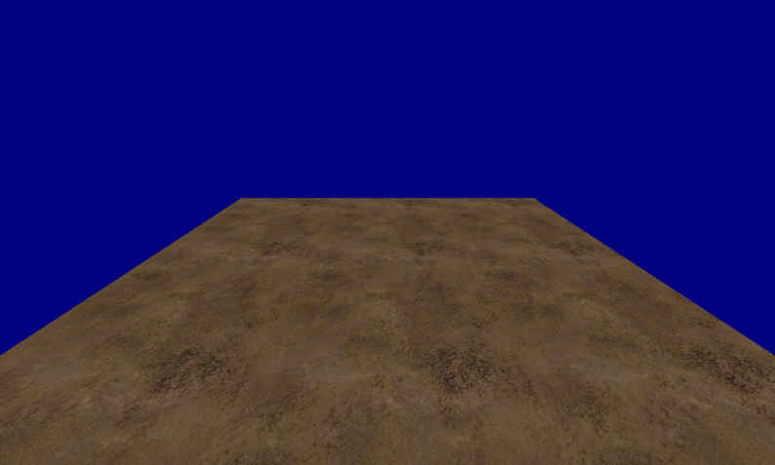
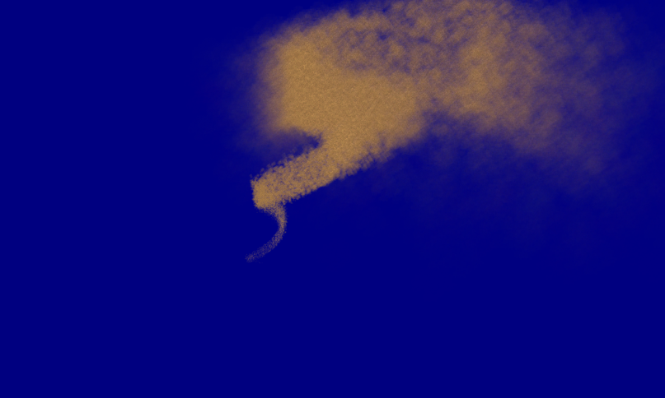

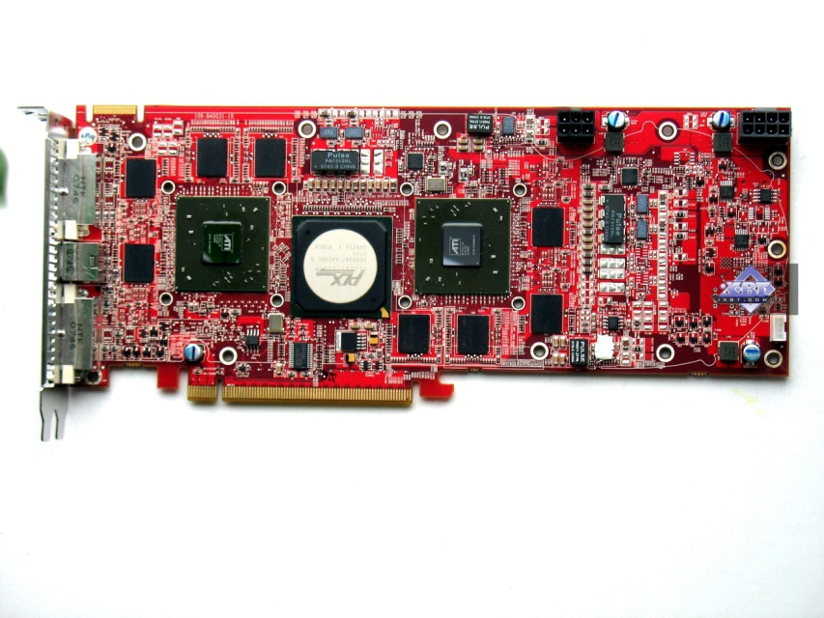
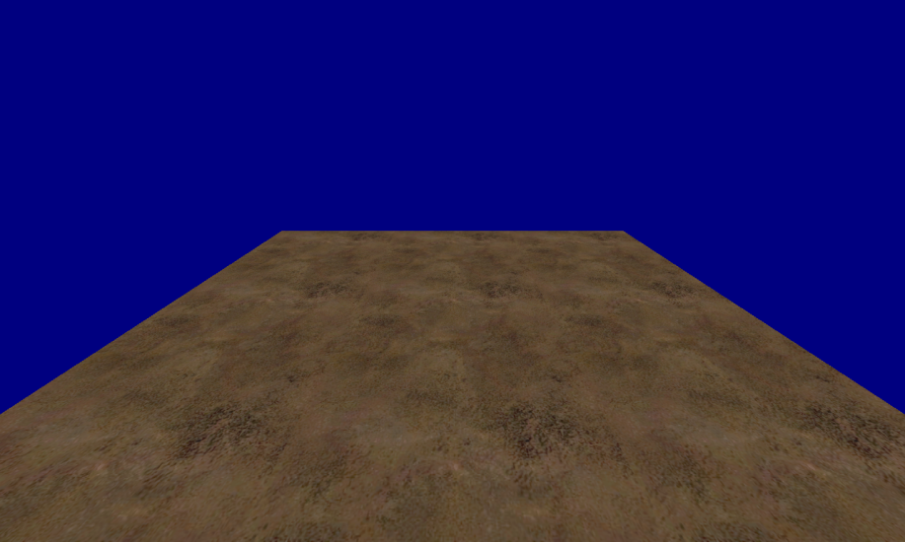

Multithreaded Rendering
CORE A
CORE B
Command Lists
Execute

Slide 14
Loading Resources
The ID3D11Device is free-threaded!
This means we can load buffers, textures, shaders and create various interfaces even while another thread is rendering!
In older APIs like DX9 and DX10 attempting to sync such behaviors without incurring large performance losses could be difficult!
This was because creating a resource would block the GPU. This is no longer the case!

Slide 15
The Immediate Context
Up till now you have been using an immediate context.
Commands execute immediately.
Only the immediate context can issue commands to the video card.
Has the ability to execute pre-recorded commands via an ID3D11CommandList.
Created at the same time as the Device.
Any ID3D11DeviceContext is NOT thread safe!
It is recommended you keep both your DXGISwapChain and Immediate Context on the main thread.
This will make handling windows events like Resizes and Full Screen switches a bit easier.

Slide 16
The Deferred Context
Designed to be used from other threads, records commands issued to it.
By recording commands on another thread we can split up the CPU overhead of calling D3D11 functions.
Even more importantly we can split up our own code used to determine what commands we will issue.
When we are finished we call “FinishCommandList” and receive an ID3D11CommandList containing an optimized playback set.
After all of our threads have completed, we take the resulting command lists and give them to the Immediate Context for optimized linear execution.
Create a Deferred Context with: “ID3D11Device::CreateDeferredContext”

Slide 17
Deferred Continued…
Once again, ANY ID3D11DeviceContext is NOT thread safe! (deferred included!)
By default each ID3D11DeviceContext maintains its own specific pipeline state.
Although you can interlink states to a small degree, it is generally recommended that you keep each context’s pipeline state in isolation.
This means that if you alter a pipeline setting on the Immediate Context or a separate Deferred, DO NOT expect that change to be reflected in any other Context.

Slide 18
ID3D11CommandList
The command list is at the heart of multi-threaded rendering in D3D11.
A command list allows you to save the actions of a deferred context.
A command list must be executed on an immediate context.
A command list records pipeline changes and draw commands. It DOES NOT record the contents of referenced resources.
This actually a good thing, we can modify things like constant buffers without having to remake our command lists.
You must keep in mind that command lists are only valid as long as the resources they reference are also valid.

Slide 19
Multi-Threading: Example
// draw geometry if it exists
void DrawThread(Application* myApp)
{
if(myApp->GeometryBuffer) // only draw once data has been loaded
{
//... setup D3D pipeline using deferred context ...
myApp->deferredContext_1of3->Draw( ... );
// complete recording of commands
myApp->deferredContext_1of3->FinishCommandList( &MyRecordedDrawCommands );
}
}
// Load some resources
void ReadModelThread(Application* myApp, string ModelPath)
{
// Open file & read vert data ...
file_io_nsuch( ModelPath );
// make our vert buffer with the free-threaded device
myApp->d3dDevice->CreateBuffer( myApp->GeometryBuffer );
}
// standard init stuff except we can launch some threads to speed up loading
void Application::Init_notAthread() // the Main Thread
{
// ... setup window and D3D ... then launch loading threads
myLoadingThread = std::thread( ReadModelThread, this, "ModelFolder\Ninja.obj" );
}
// DXGISwapChain and ImmediateContext are recommended to stay on the main thread.
void Application::MainLoop_notAthread() // the Main Thread
{
// Launch threads... (just one here but could be more!)
myDrawingThread = std::thread( DrawThread, this );
// do some other stuff.. like say editing constant buffers or something...
// more other stuff...
// hopefully the other thread is done now to...
WAIT_FOR_THREAD(myDrawingThread); // are we there yet?
// good we are ready! execute pending commands
immediateContext->ExecuteCommandList( MyRecordedDrawCommands );
MyRecordedDrawCommands.Release(); // done with this one make it again next frame.
// present the results!
swapChain->Present( ... );
}

Slide 20
Tips For Lab:
Don’t go overboard on threading till you get used to it.
For now just try making one separate loading thread and one separate rendering thread.
Remember that textures (just like constant buffers) are assigned to a particular slot.
If two vertices share the same XYZ position but have differing UVs… They are two DIFFERENT VERITCES!

Slide 21
Instanced Geometry
Instancing is a technique used when you need to draw the same object in many different locations/styles.
It significantly improves performance by cutting down GPU bandwidth allowing the GPU to re-draw a set of vertices multiple times.
Common uses for instancing include foliage, bullets, units(RTS) and anything else that needs to be rendered over and over again.
To use instancing you can call DrawInstanced() or DrawIndexedInstanced() and tweak your InputLayout and Vertex Shaders to include “Per-Instance” data alongside your vertices.

